Slide 1

FY2027 Draft Budget
Who We Are, How We Support Our Community and a Draft of our Financial Budget

Slide 2
About Us
Notes:
Our services are organized into 4 main areas: Adult Behavioral Health Services, Child & Family Services, Crisis Services and Intellectual and Developmental Disabilities Services.
We have over 30 programs but I’d like to give you a high-level view of the different ways we improve the health and well-being of our community.
NOTE: Remove services that aren’t relevant to your presentation.

Slide 3
Who We Are and Who We Serve
Integral Care is the Local Mental Health Authority (LMHA) and Local Intellectual and Developmental Disability Authority (LIDDA) for Travis County. ​
We provide high-quality, low-cost healthcare and social services to anyone affected by mental health conditions, substance use disorders, and intellectual or developmental disabilities in Travis County.
Our vision is Mental Health and Well-Being for Everyone.

Slide 4
Our History
1967: Established as local authority for mental health and intellectual and developmental disabilities in Travis County as designated by state law​
1 of 39 Community Mental Health Centers in Texas​
Governed by a Board of Trustees appointed by Central Health, City of Austin and Travis County​
Authority and Provider Roles

Slide 5
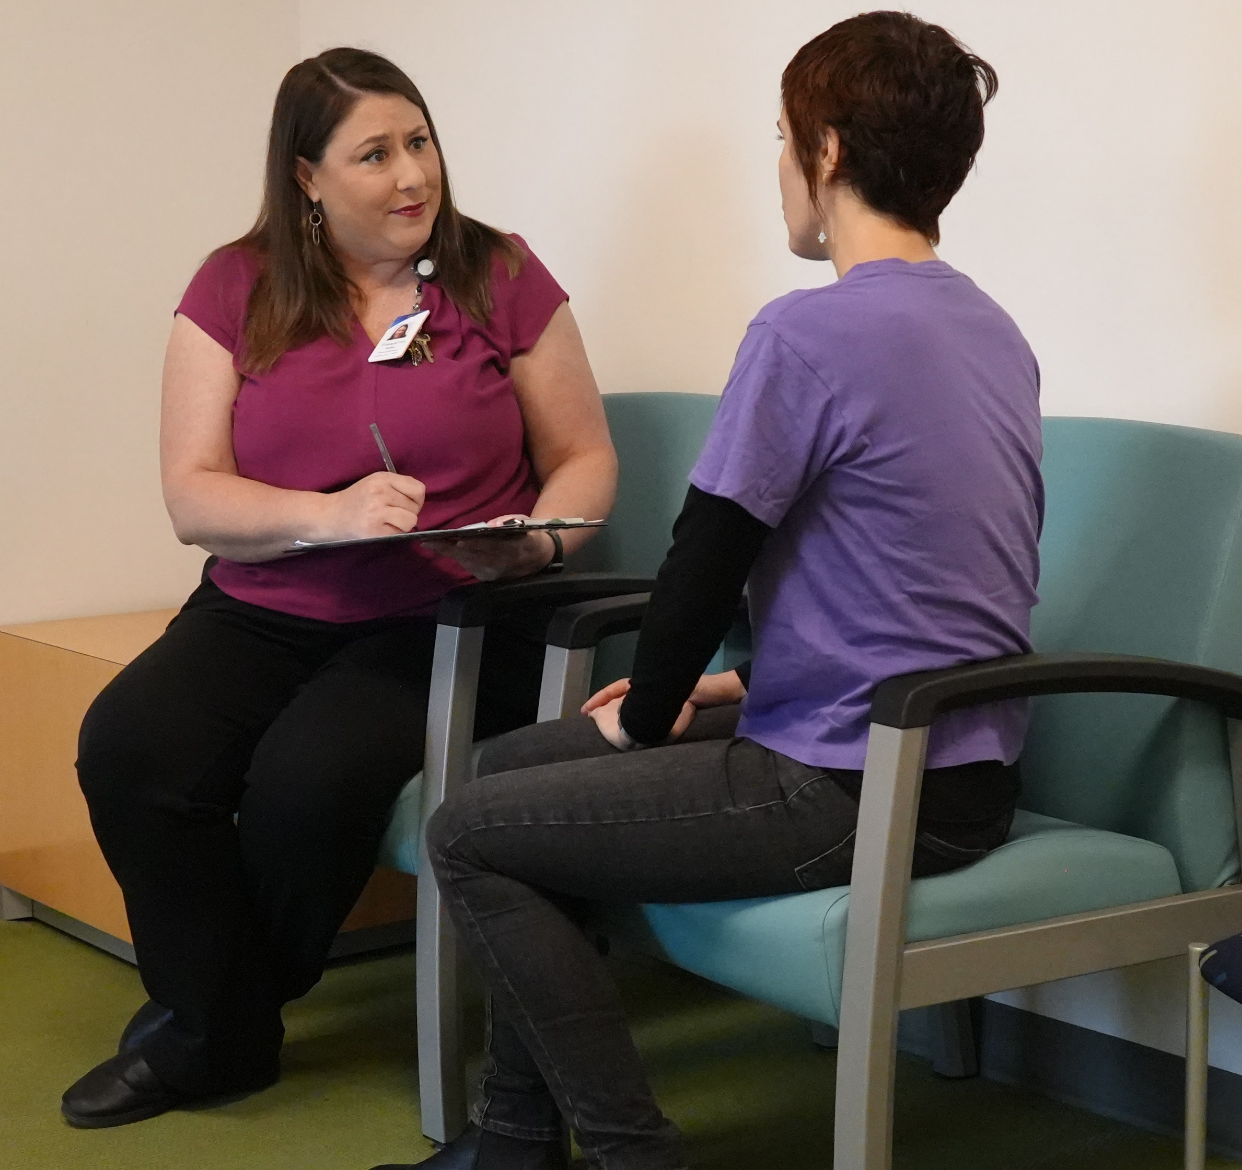
What We Do - Provider
Care Coordination
24/7 Crisis Response
Integrated Behavioral Health
Residential Services
Homelessness and Housing Services
Jail Diversion
Substance Use Treatment
Prevention and Wellness

Slide 6
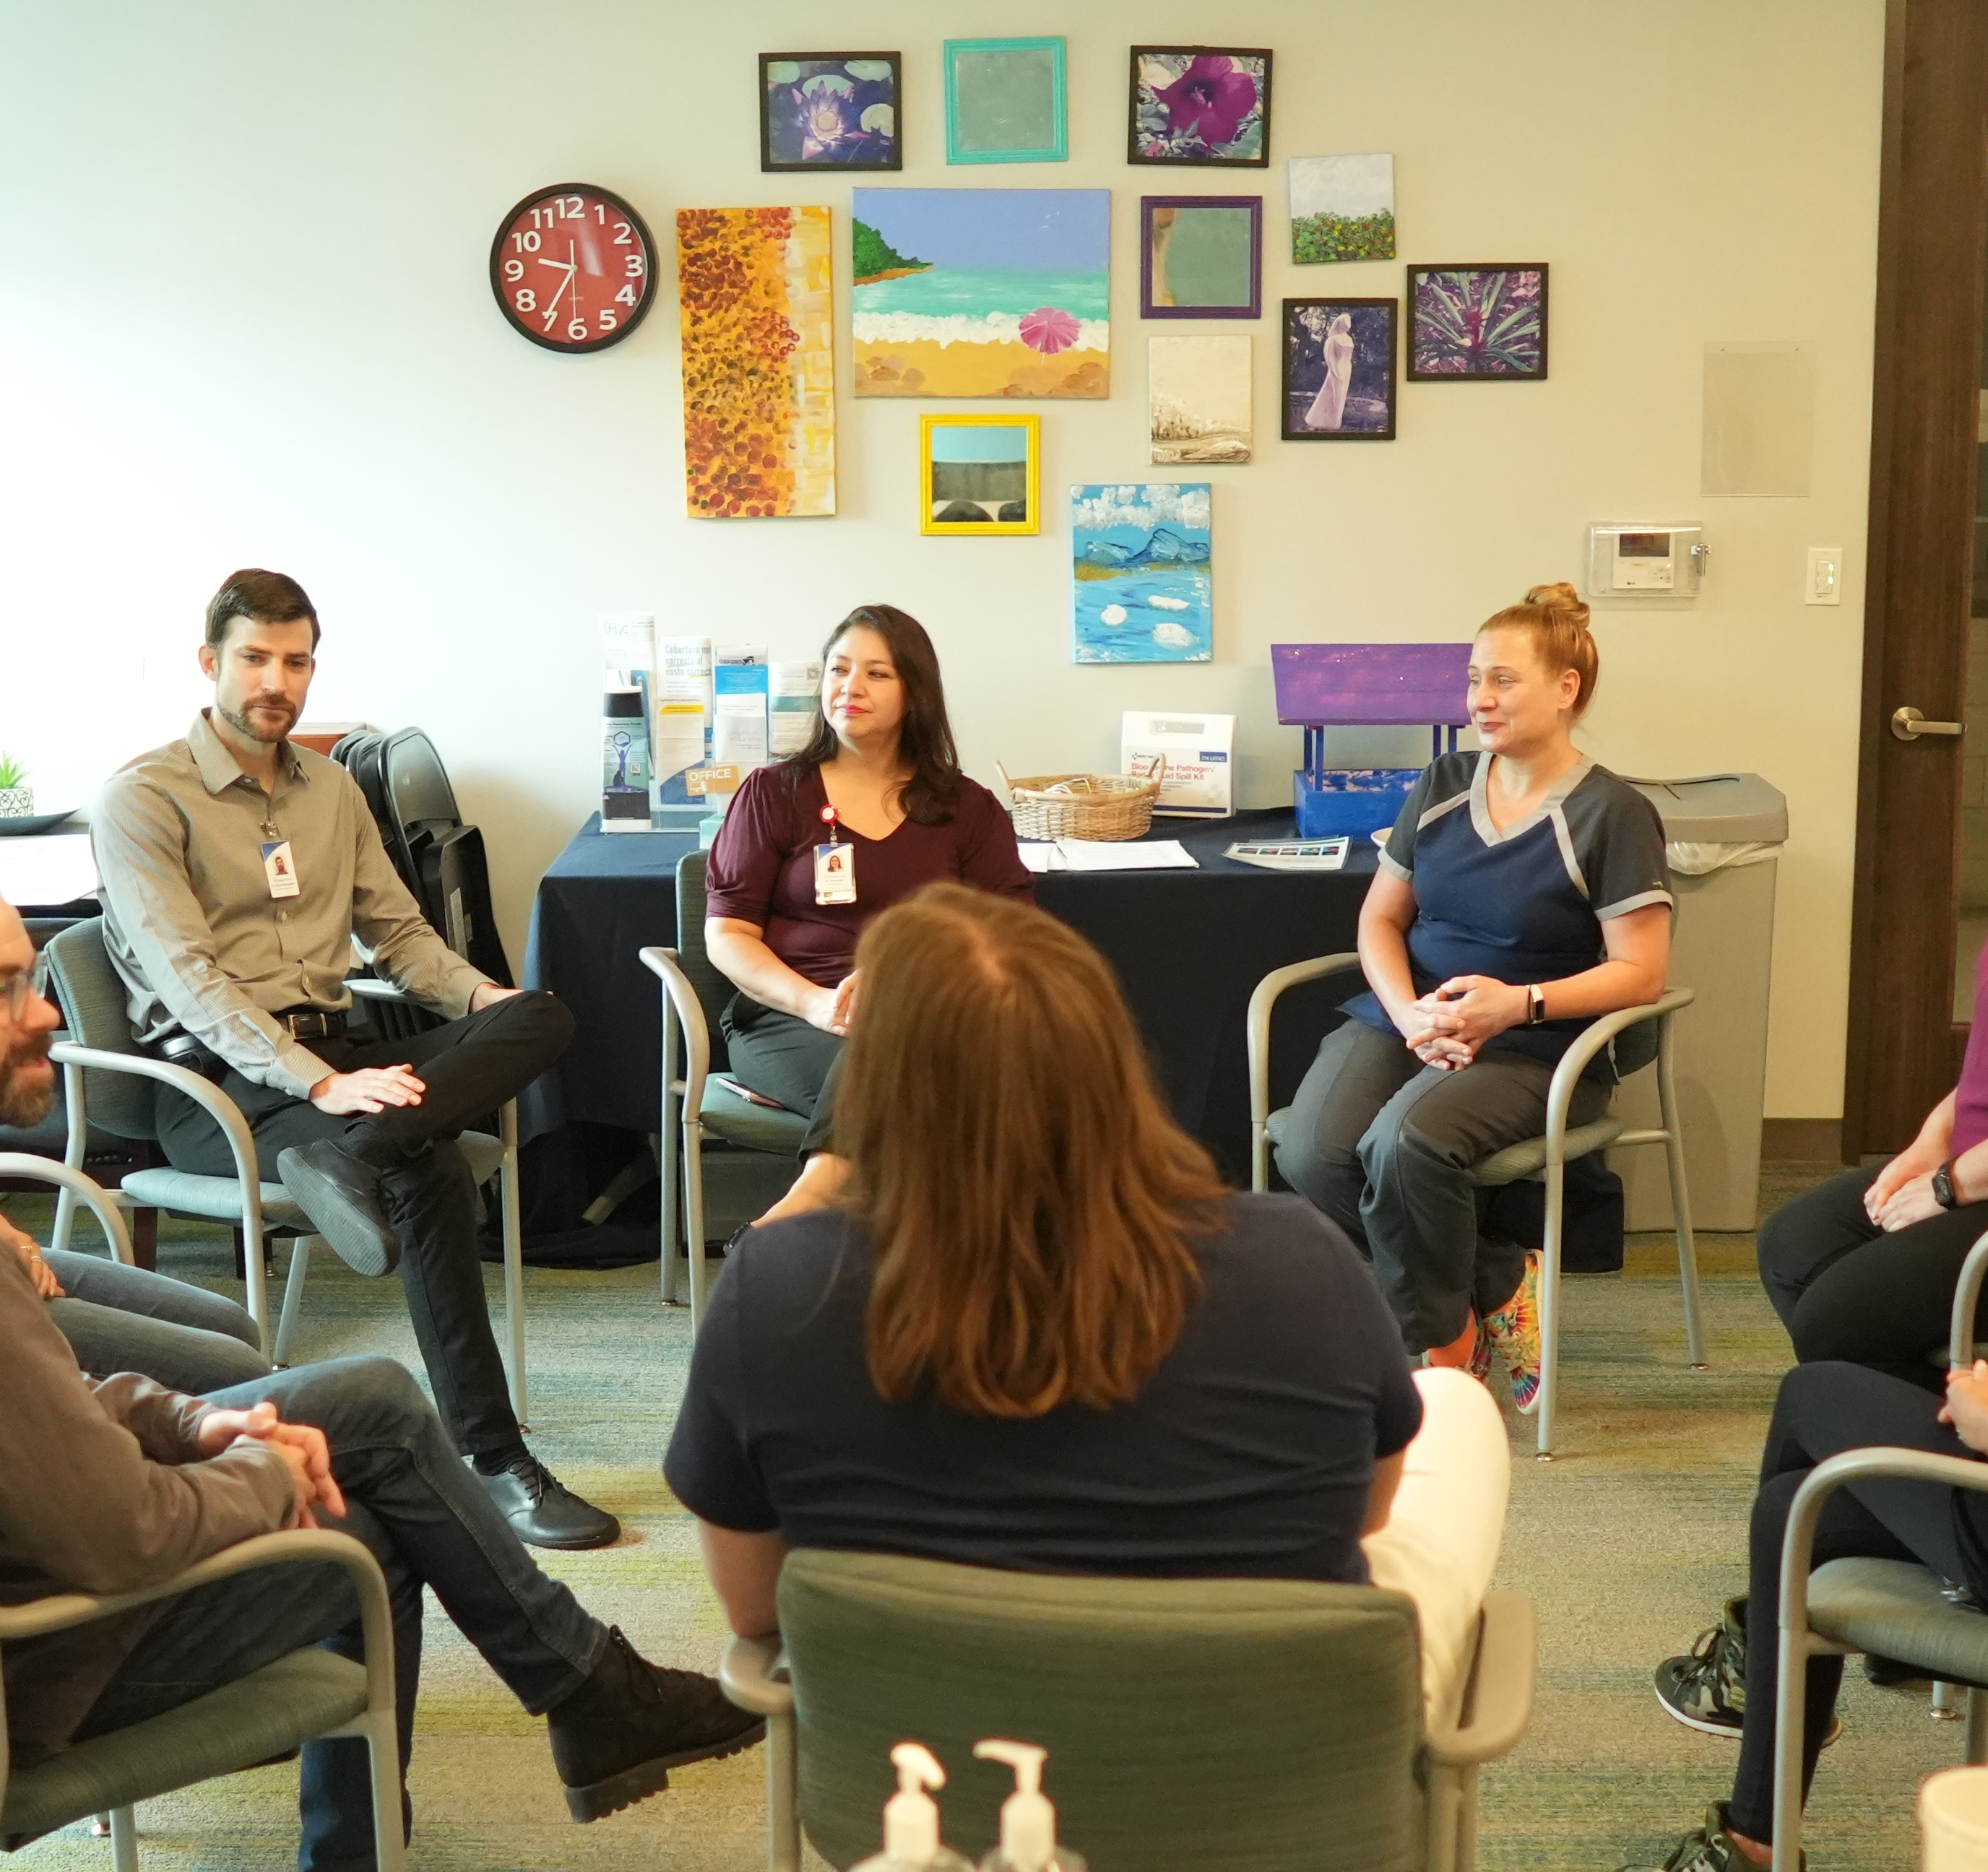
What We Do - Authority
Education & Training
Manage service quality and patient access for inpatient and outpatient care
Network Development, Credentialing & Management
Local Service Plan & Local Network Development Plan
Strategic Planning & Coordination

Slide 7










Our Partners

Slide 8
Where We Serve
Notes:
Our services are organized into 4 main areas: Adult Behavioral Health Services, Child & Family Services, Crisis Services and Intellectual and Developmental Disabilities Services.
We have over 30 programs but I’d like to give you a high-level view of the different ways we improve the health and well-being of our community.
NOTE: Remove services that aren’t relevant to your presentation.

Slide 9
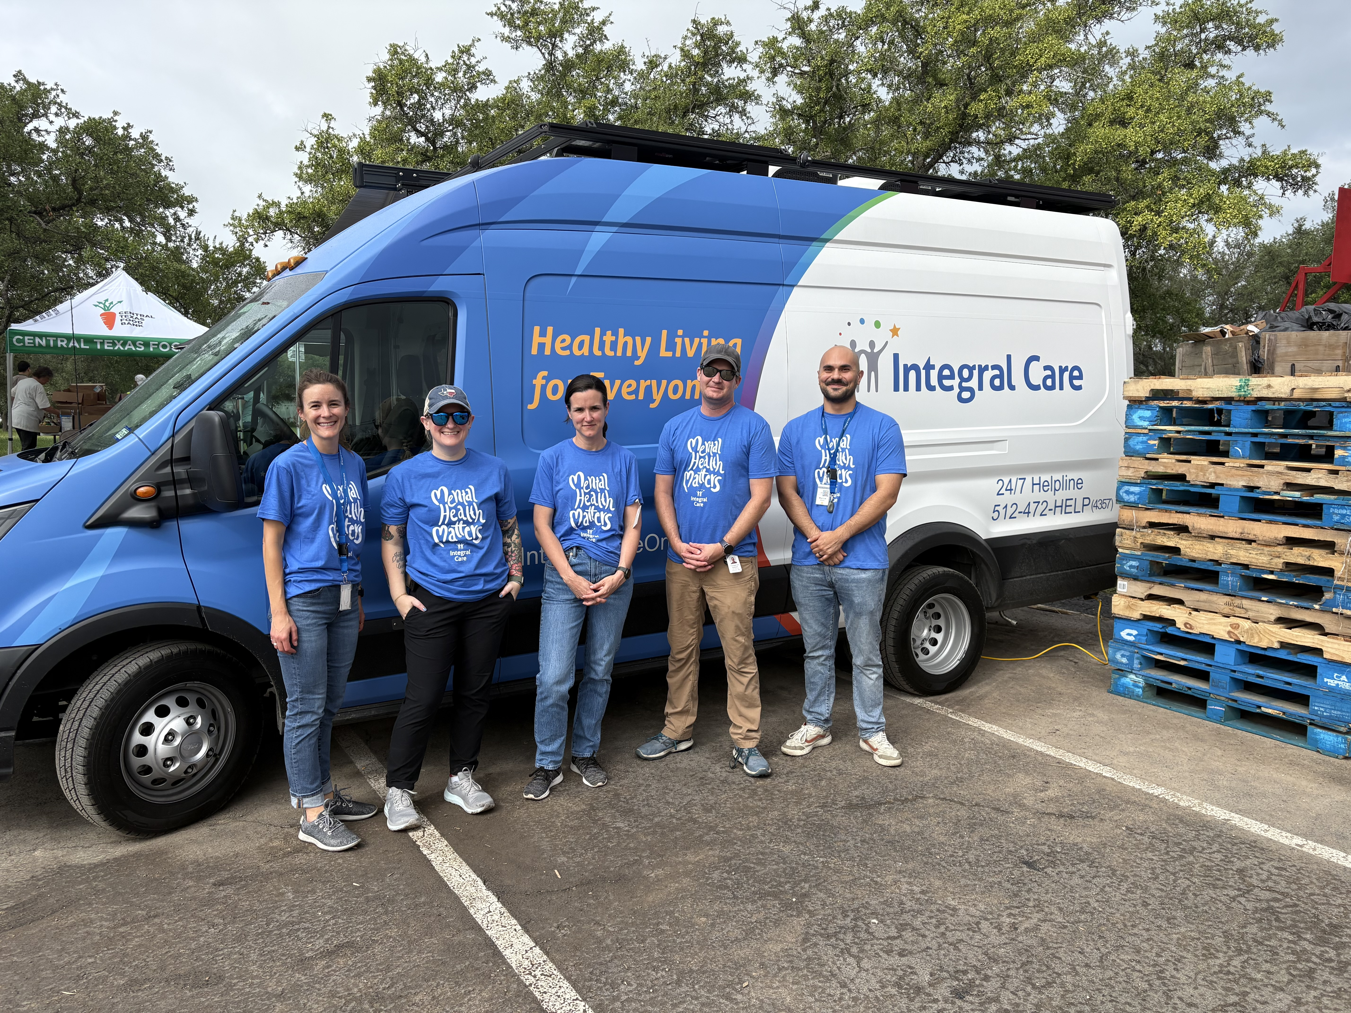
Where We Provide Services
Over the phone​
Via telehealth​
On a street corner ​
In homes​
In jails​
In clinics and residential facilities​
In emergency rooms​
In schools​
In mobile clinics

Slide 10
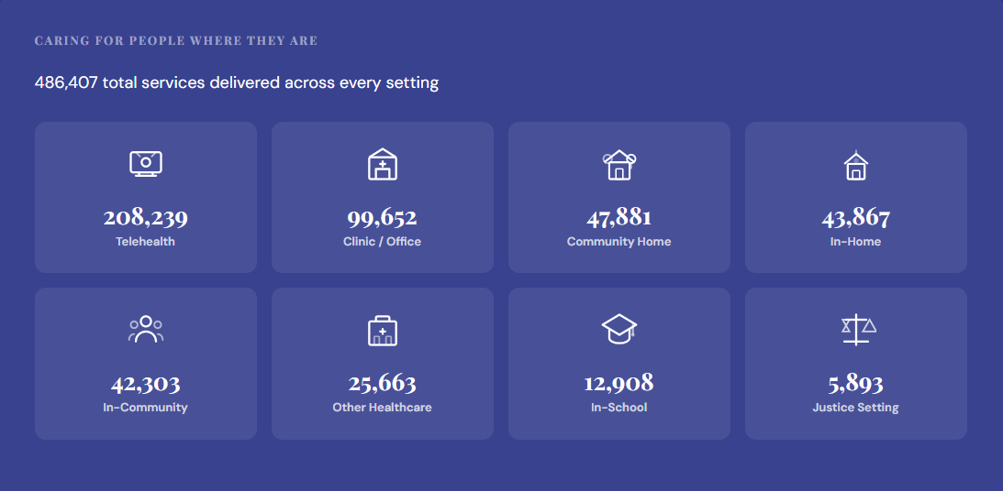
Where We Serve, By the Numbers

Slide 11
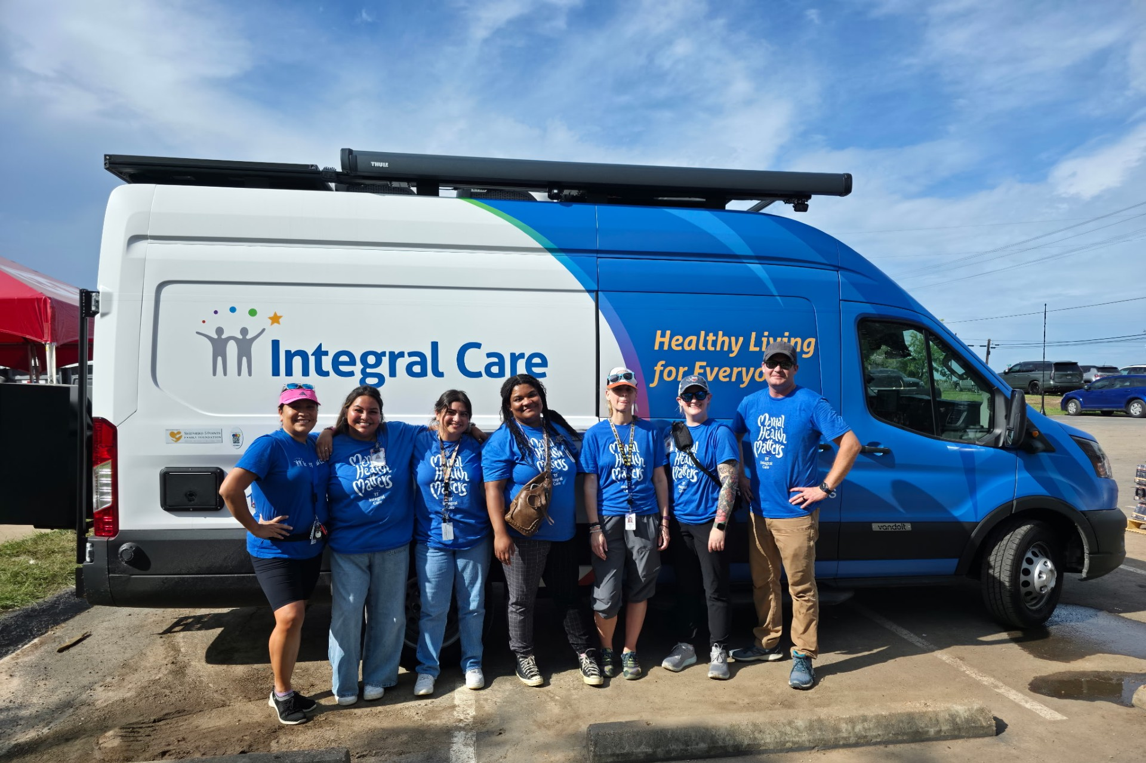
Mobile Clinics: Meeting Clients Where They Are
Launched in February 2025, the mobile mental health van dedicates 70% of its time to serving individuals experiencing homelessness.
The mobile unit travels to high-need locations including:
    Homeless shelters
    Encampments
    Downtown Austin Community Court
    Rural and underserved areas across Travis County
Fully equipped hub for integrated care, outfitted to deliver mental health, substance use, and general medical services in the field.
Notes:
Mobile Behavioral Health Clinics break through barriers by bringing care directly to the people who need it most.

Slide 12
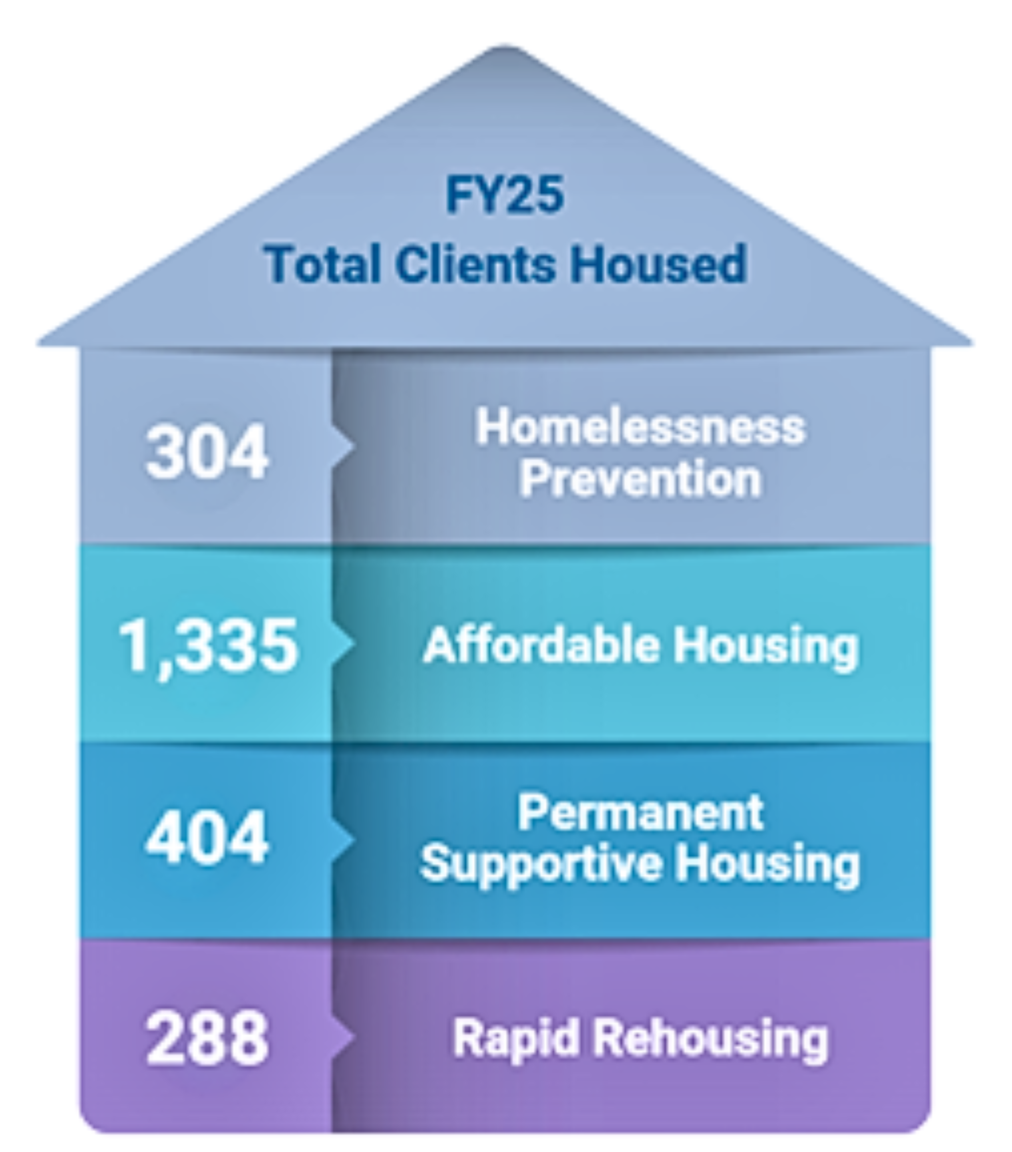
Housing Services Impact
Stable housing is foundational to recovery, health, and overall well-being.
In FY25, 1 in 5 Integral Care clients experienced homelessness.
A full continuum of housing and homeless services to move individuals from crisis and street homelessness to long-term housing stability.
Homelessness prevention, rapid rehousing, affordable housing development, and permanent supportive housing.
In FY25, 3,932 clients were served through Homeless Outreach & Housing Services.
Notes:
Currently, Integral Care operates two Permanent Supportive Housing complexes:
The Terrace at Oak Springs (50 units)
The Bungalows at Century Park (60 units)
Seabrook Square (opening March/April 2026) (60 units)
Together these apartment complexes provide 110 apartment units for our residents, plus on-site services like healthcare, counseling, job assistance, and more, all in one place. This helps people get their lives back on track and stay there- for good.

Slide 13
Who We Serve
Notes:
Our services are organized into 4 main areas: Adult Behavioral Health Services, Child & Family Services, Crisis Services and Intellectual and Developmental Disabilities Services.
We have over 30 programs but I’d like to give you a high-level view of the different ways we improve the health and well-being of our community.
NOTE: Remove services that aren’t relevant to your presentation.

Slide 14
FY25 Overview
29,327
486,407
1,172
30+
Total Clients Served
Services provided
Integral Care Staff
Programs and services offered

Slide 15
Number of Services Provided FY25
486,407
Total services provided

Slide 16
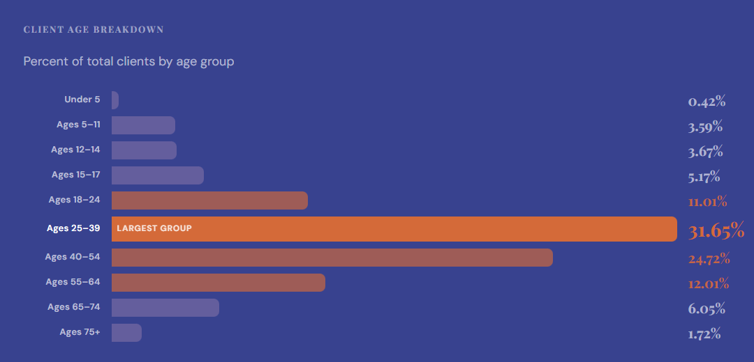
Client Demographics FY25 | Age

Slide 17
FY27
Draft Budget
Notes:
Our services are organized into 4 main areas: Adult Behavioral Health Services, Child & Family Services, Crisis Services and Intellectual and Developmental Disabilities Services.
We have over 30 programs but I’d like to give you a high-level view of the different ways we improve the health and well-being of our community.
NOTE: Remove services that aren’t relevant to your presentation.

Slide 18
FY27 Budget Priorities → Strategic Plan Alignment
Budget priority
Strategic plan pillar + definition
1
Invest in our workforce
PILLAR 4
Keeps great staff and strengthens service quality
Workforce Talent, Well-Being & Effectiveness
Compensation • Benefits • Wellness • Training • Staff tools
Definition: Healthy, supported, high-performing workforce
2
Invest in critical infrastructure
PILLAR 5
Modernizes systems so operations move faster
Technology & Data Systems
Facilities • IT • Data systems • Integrated Workflows
Definition: Integrated systems, timely decisions, AI and automation
3
Respond to funding environment
PILLAR 6
Protects stability and diversifies funding
Financial Sustainability & Stewardship
Funder shifts • Unfunded programs • Fundraising capacity
Definition: Flexible mission-aligned funding to sustain and grow impact
4
Community-wide behavioral health initiatives
PILLARS 1 + 2 + 3
Builds community-wide system impact
Collaboration + Continuum of Care + Access
Crisis center • Diversion • Inpatient capacity • No Wrong Door
Definition: System connection, full continuum, accessible person-centered care
Bottom line: The FY27 budget is balanced and visibly anchored in the Board-approved strategic plan.
People • Infrastructure • Sustainability • Community impact
Notes:
[Sources]
- Budget priorities and supporting phrases are drawn from FY27 Budget - Finance Committee.pptx, slide 2.
- Pillar labels and definitions are based on the goals in 251016-Integral Care - Strategic Plan Report.pdf: Pillar 4 workforce, Pillar 5 technology and data systems, Pillar 6 financial sustainability, and Pillars 1 through 3 on collaboration, Continuum of Care, and accessible person-centered care.
- Visual layout, icons, connectors, and synthesis were created with Microsoft Copilot.

Slide 19
integral care
REVENUE — FY27 Budget vs FY26 Actual Run Rate Projection
All figures in $millions
 | FY27 Budget | FY26 Act. Proj. | Delta ($/%) | Notes
City of Austin | $13.7M | $15.2M | ($1.5M) (10.0%) | COA budget discussions are ongoing – estimate based on communications from COA
Travis County | $16.3M | $16.3M | +$0.0M +0.0% | TC has not completed their budget, but we are expecting a flat value
Central Health | $27.5M | $24.1M | +$3.4M +14.2% | Based on current discussions with CH, we anticipate some shifts coming from them
Other Local | $3.9M | $4.3M | ($0.4M) (9.4%) | Loss of funding (e.g. SDF) partially offset by increased private fundraising
Local Total | $61.4M | $59.9M | +$1.5M +2.5%
State Funds | $74.1M | $69.2M | +$4.9M +7.0% | Unlikely to be fully realized based on history
Federal Funds | $13.8M | $13.7M | +$0.0M +0.4%
DPP / PHP-CCP | $14.4M | $15.0M | ($0.6M) (3.8%) | Expected less $’s due to prior years’ patterns and increased CH funding
TOTAL REVENUE | $163.7M | $157.8M | +$5.8M +3.7%

Slide 20
integral care
REVENUE BRIDGE: FY26 Act. Proj. → FY27 Budget
$165M
+4.87M
+0.05M
-0.57M
$163.7M
$160M
+3.43M
-0.40M
$157.8M
-1.52M
+0.00M
$155M
FY26 Act. Proj.
City of
Austin
Travis
County
Central
Health
Other
Local
State
Funds
Federal
Funds
DPP /
CCP
FY27
Budget

Slide 21
integral care
EXPENSE OVERVIEW — FY27 Budget vs FY26 Actual Run Rate Projection
 | FY27 Budget | FY26 Act. Proj. | Delta ($/%) | Notes
Salaries | $87.4M | $87.4M | +$0.0M +0.0% | Turnover estimate included
Fringe Benefits | $25.5M | $23.2M | +$2.3M +9.8% | Medical cost increase
Contracts & Consult. | $27.2M | $28.0M | ($0.9M) (3.1%)
Facilities / Util. | $8.6M | $8.5M | +$0.1M +1.6%
Furn. & Equipment | $5.6M | $4.4M | +$1.2M +26.3% | Workday
Capital Outlay | $1.9M | $2.3M | ($0.5M) (20.0%)
Client Support | $3.1M | $3.1M | ($0.0M) (1.0%)
Travel / Workshop | $1.1M | $0.8M | +$0.3M +37.6% | IRS rate up 8% YoY
Other Operating | $1.3M | $2.1M | ($0.8M) (38.7%)
Insurance | $0.8M | $0.9M | ($0.0M) (5.0%) | Has not been quoted yet but reduced property
Prof. Fees / Transport | $0.5M | $0.6M | ($0.1M) (18.2%)
Supplies / Rx | $0.8M | $0.8M | +$0.0M +3.0%
TOTAL EXPENSES | $163.7M | $162.1M | +$1.6M +1.0%

Slide 22
integral care
FUNDING MIX – Direct vs Original Source
FY27 Budget – Direct Funder
FY27 – Original Source (estimate)

Slide 23
Q&A

Slide 24
Thank you.
integralcare.org
512-472-4357
24/7 HELPLINE

