Slide 1

Mission, Services, and System of Care
Who We Are and How We Support Our Community

Slide 2
A Note Before Using this Presentation
You must install our brand font Hanuman Bold before using this template.
Hanuman Bold is available to download at Google Fonts.
All slide layouts, fonts, and colors are pre-configured. You should not need to change any design settings. You may add additional content as needed.
Delete this slide before using this in a presentation.

Slide 3
About Us

Slide 4
Who We Are and Who We Serve
Integral Care is the Local Mental Health Authority (LMHA) and Local Intellectual and Developmental Disability Authority (LIDDA) for Travis County. ​
We provide high-quality, low-cost healthcare and social services to anyone affected by mental health conditions, substance use disorders, and intellectual or developmental disabilities in Travis County.
Our vision is Mental Health and Well-Being for Everyone.

Slide 5
Our History
1967: Established as local authority for mental health and intellectual and developmental disabilities in Travis County as designated by state law​
1 of 39 Community Mental Health Centers in Texas​
Governed by a Board of Trustees appointed by Central Health, City of Austin and Travis County​
Authority and Provider Roles

Slide 6
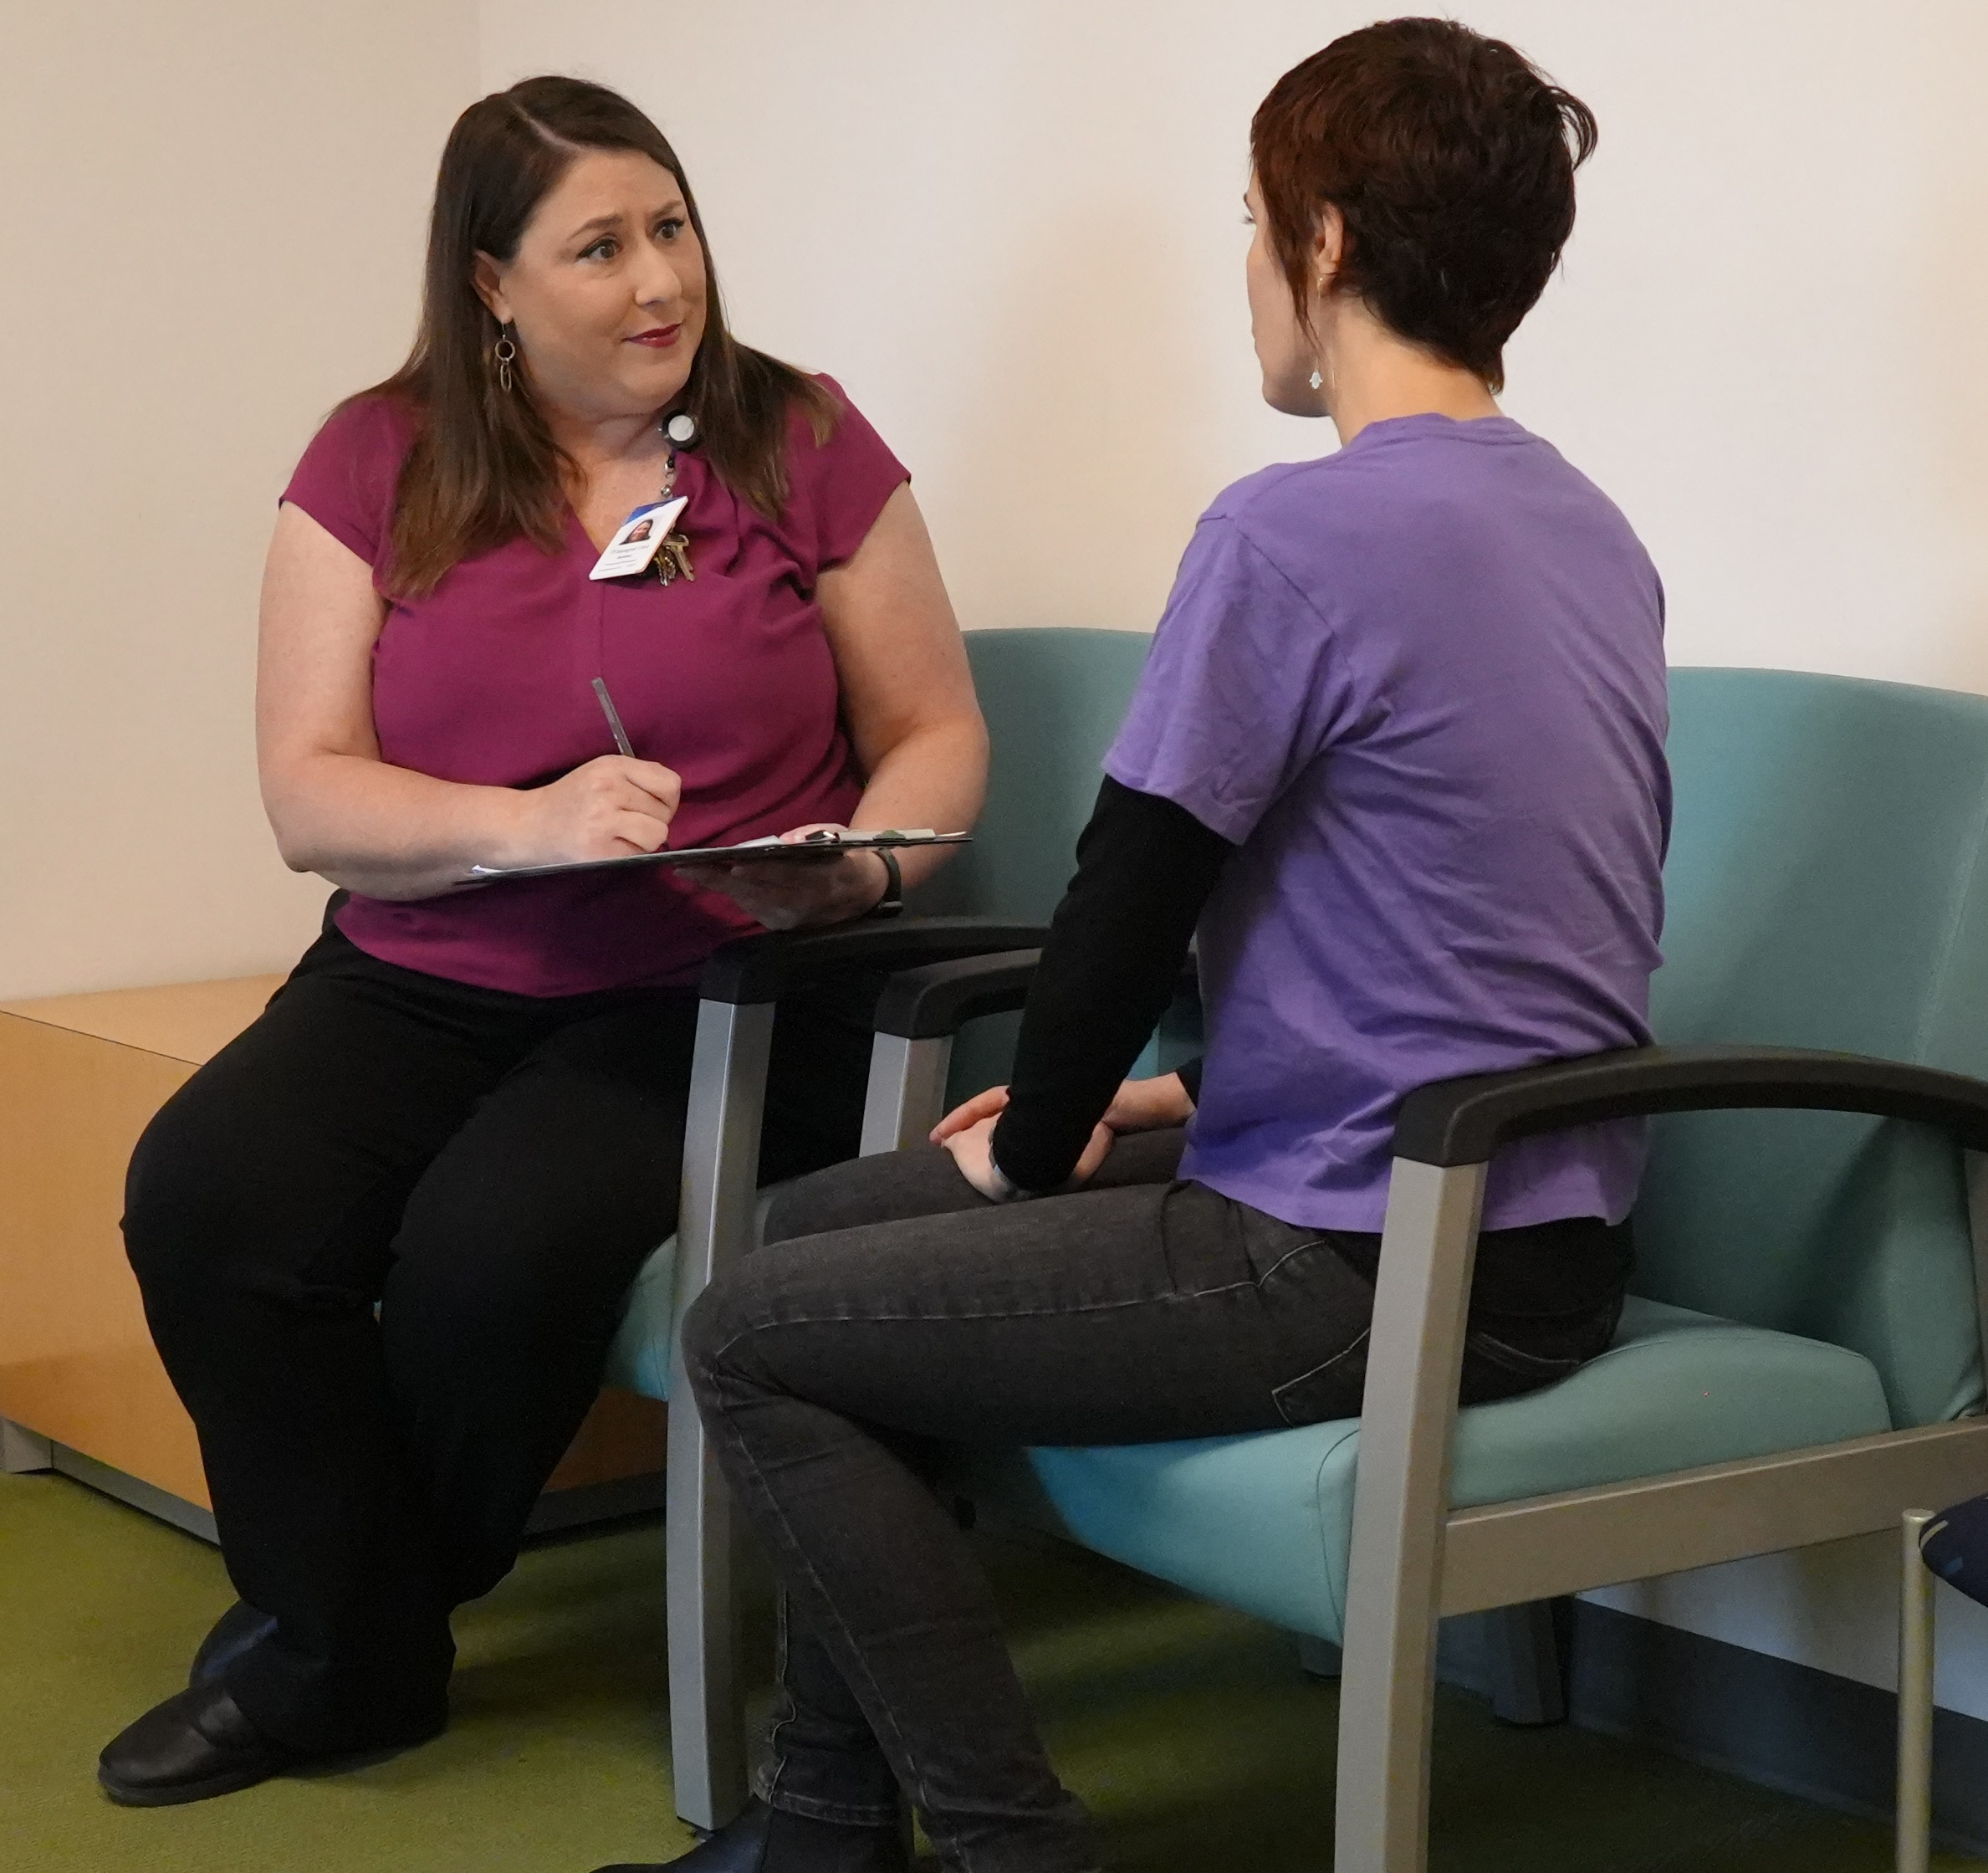
What We Do - Provider
Care Coordination
24/7 Crisis Response
Integrated Behavioral Health
Residential Services
Homelessness and Housing Services
Jail Diversion
Substance Use Treatment
Prevention and Wellness

Slide 7
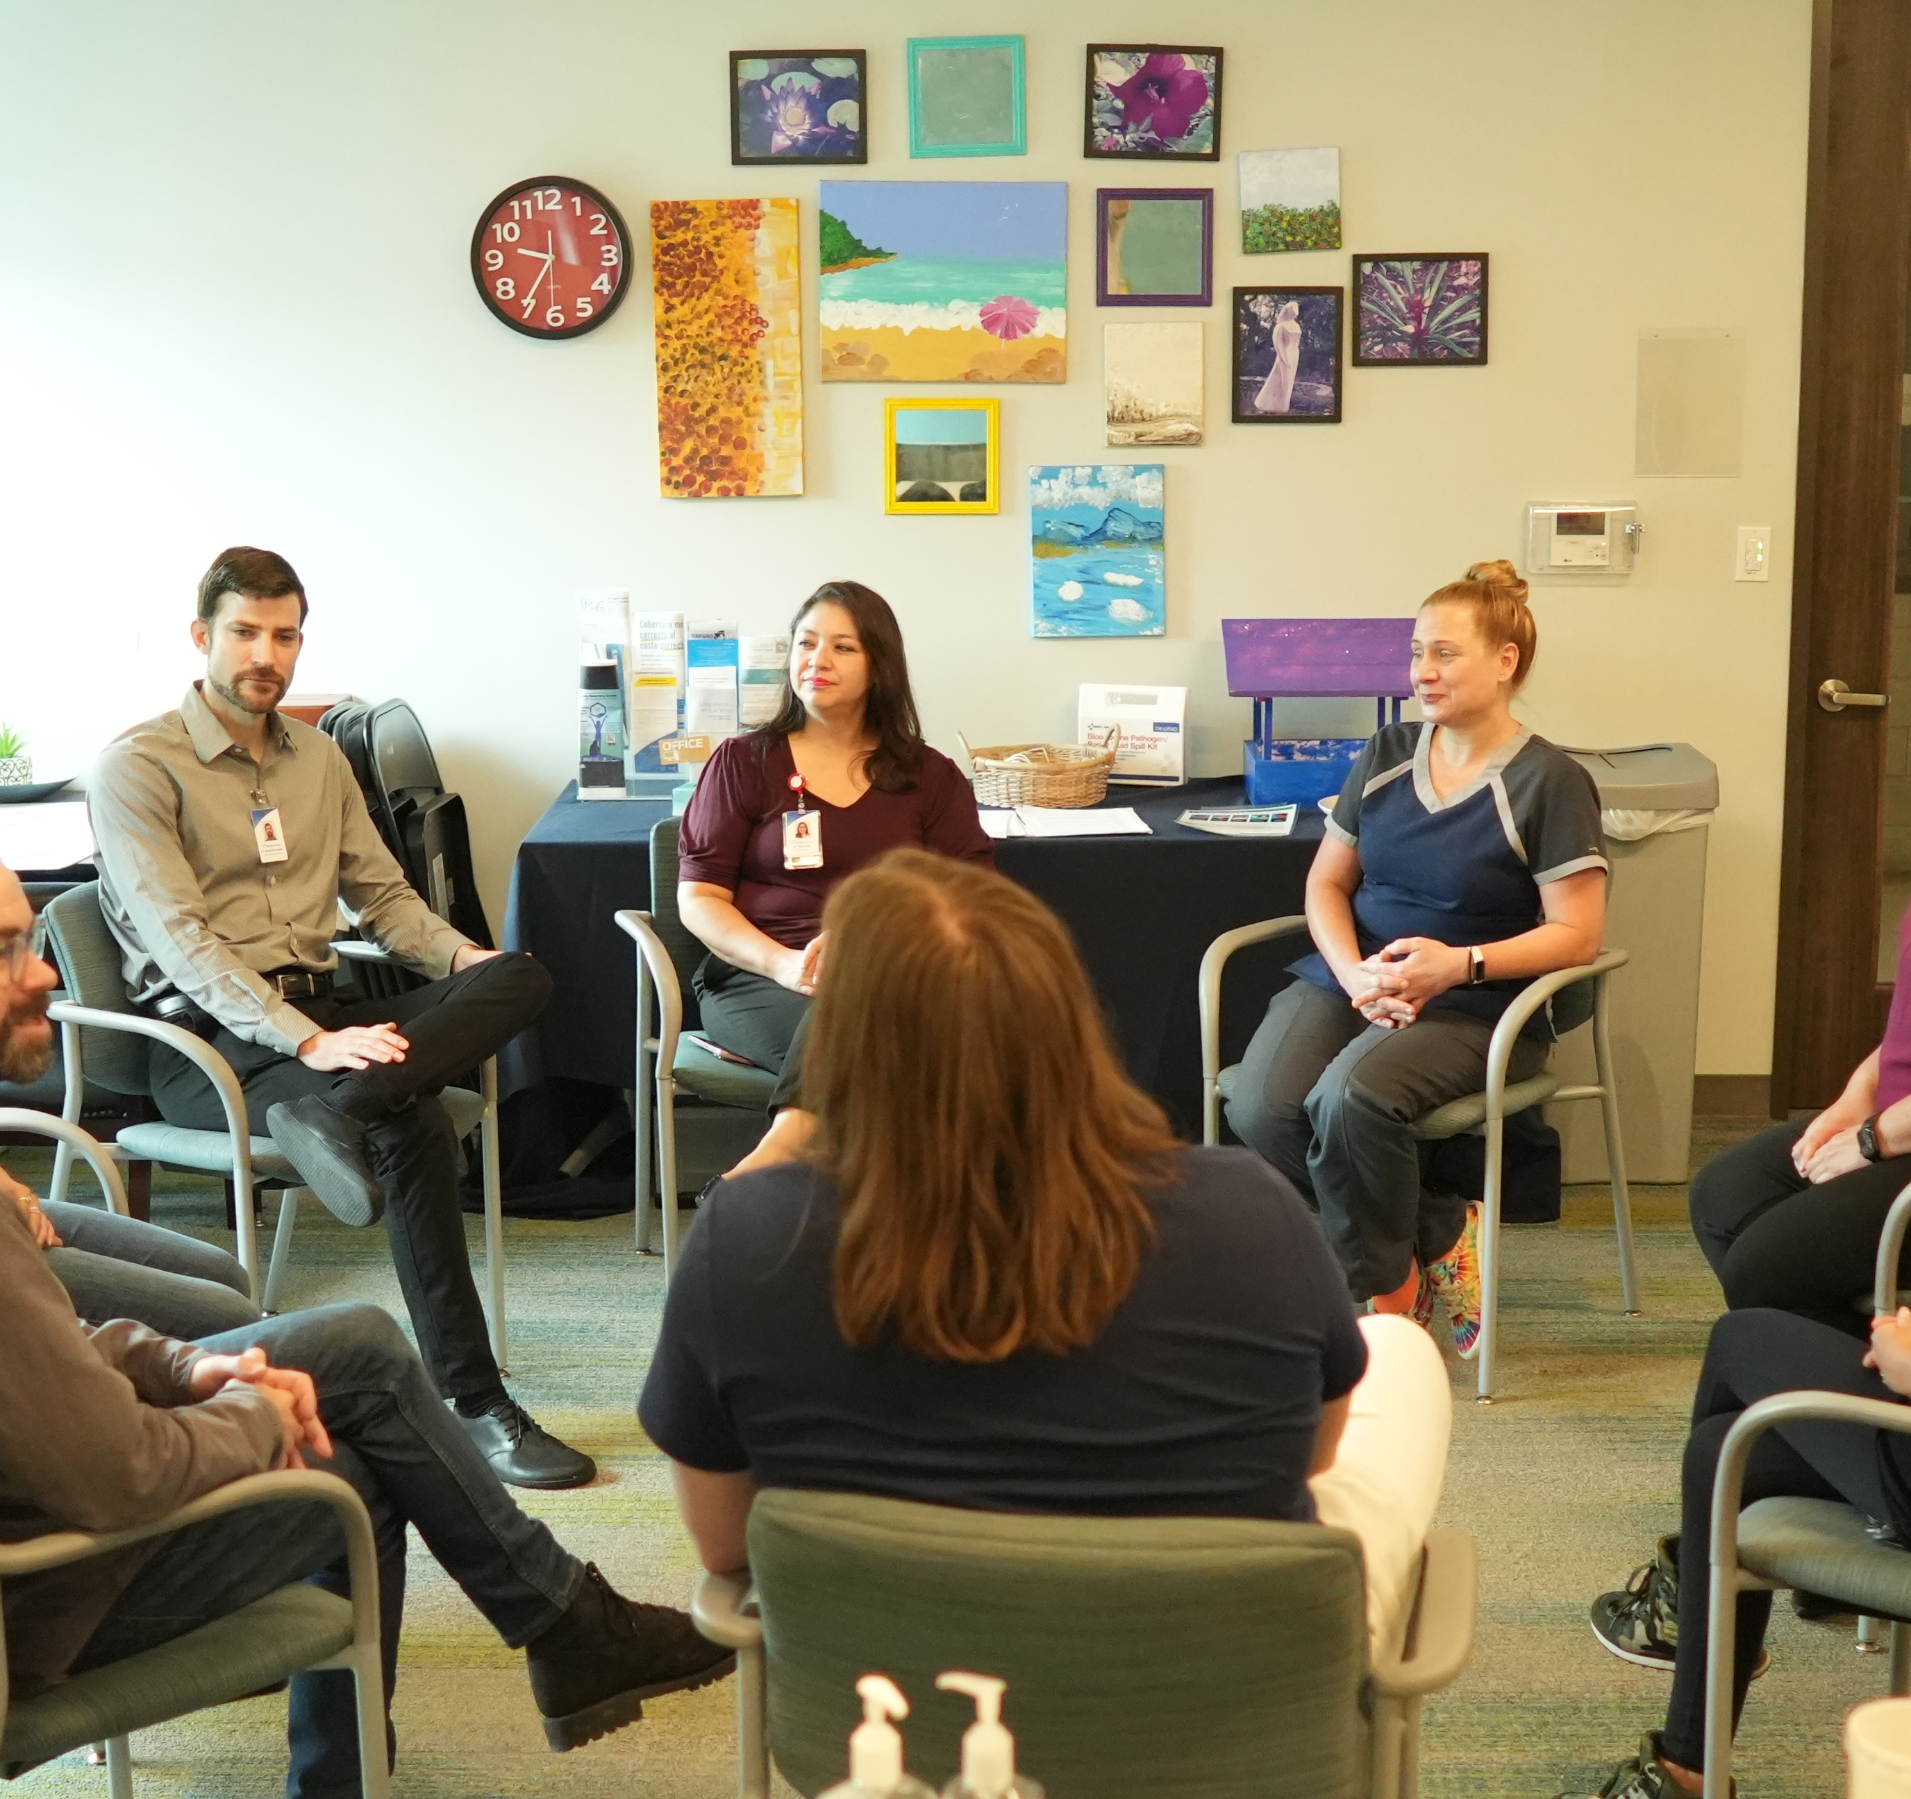
What We Do - Authority
Education & Training
Manage service quality and patient access for inpatient and outpatient care
Network Development, Credentialing & Management
Local Service Plan & Local Network Development Plan
Strategic Planning & Coordination

Slide 8
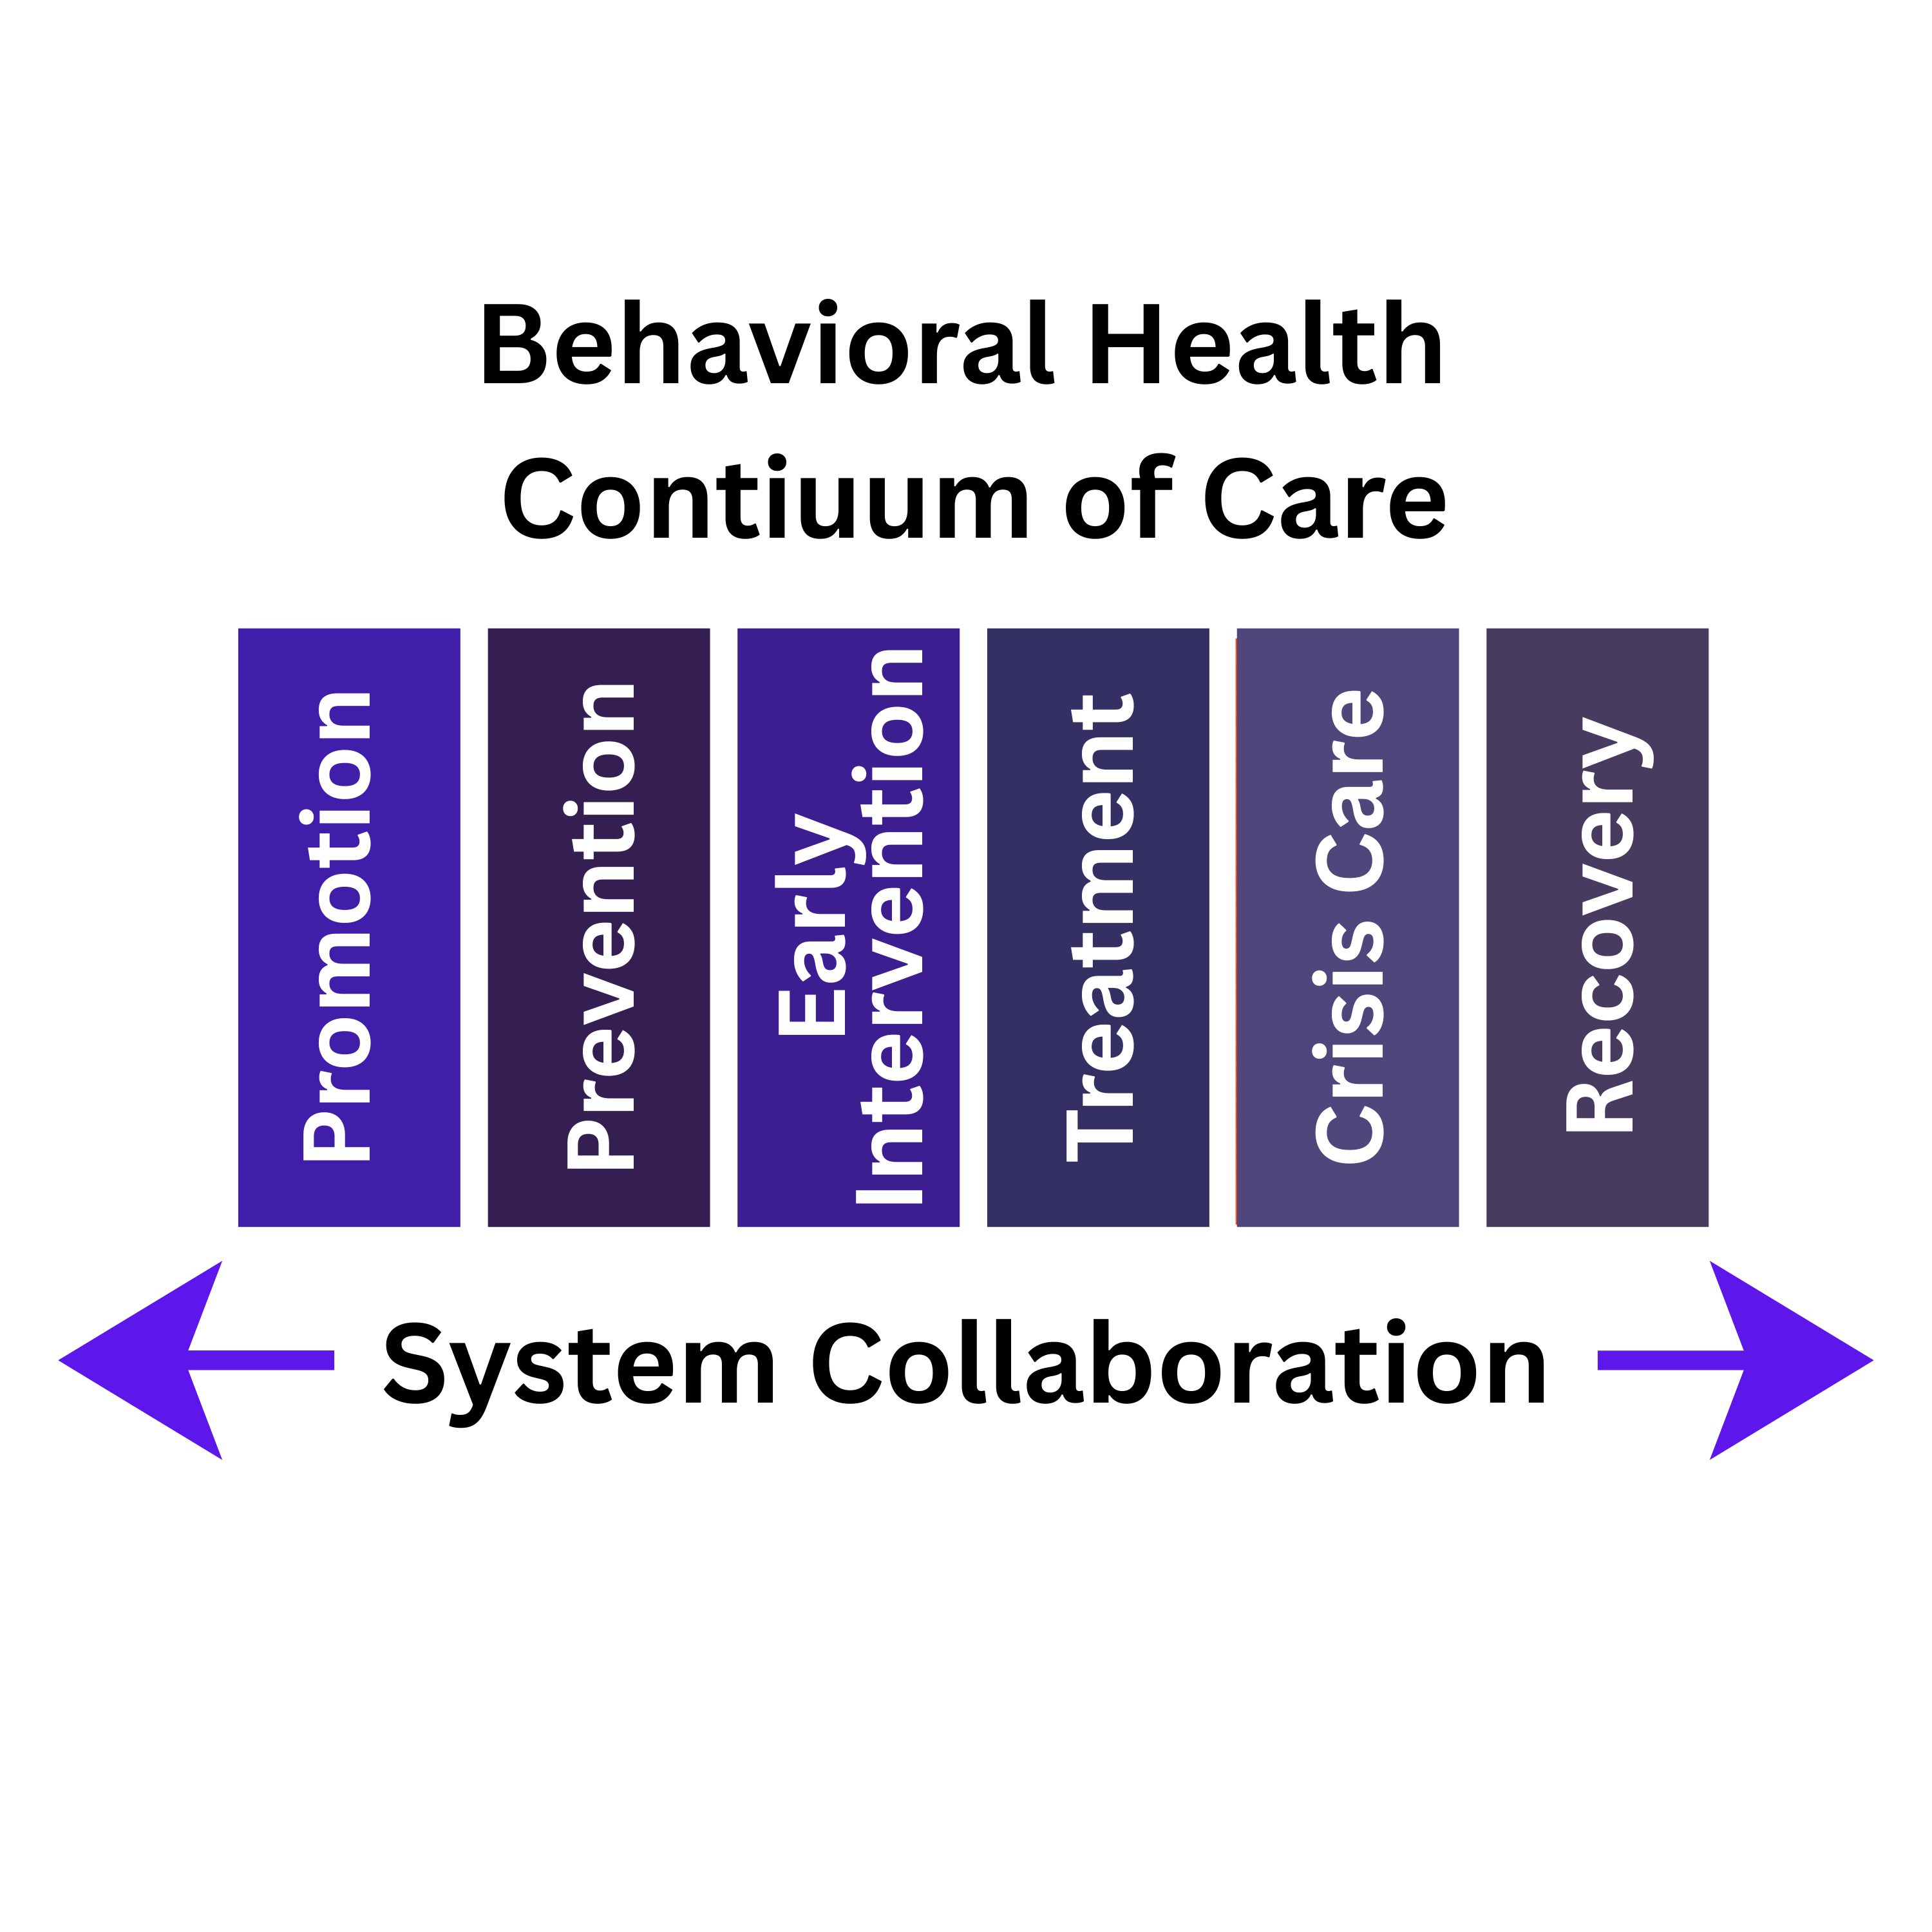
System of Care
The Institute of Medicine's continuum of care categorizes behavioral health services into four areas: promotion, prevention, treatment, and recovery.

Slide 9










Our Partners

Slide 10
Our Services
Notes:
Our services are organized into 4 main areas: Adult Behavioral Health Services, Child & Family Services, Crisis Services and Intellectual and Developmental Disabilities Services.
We have over 30 programs but I’d like to give you a high-level view of the different ways we improve the health and well-being of our community.
NOTE: Remove services that aren’t relevant to your presentation.

Slide 11
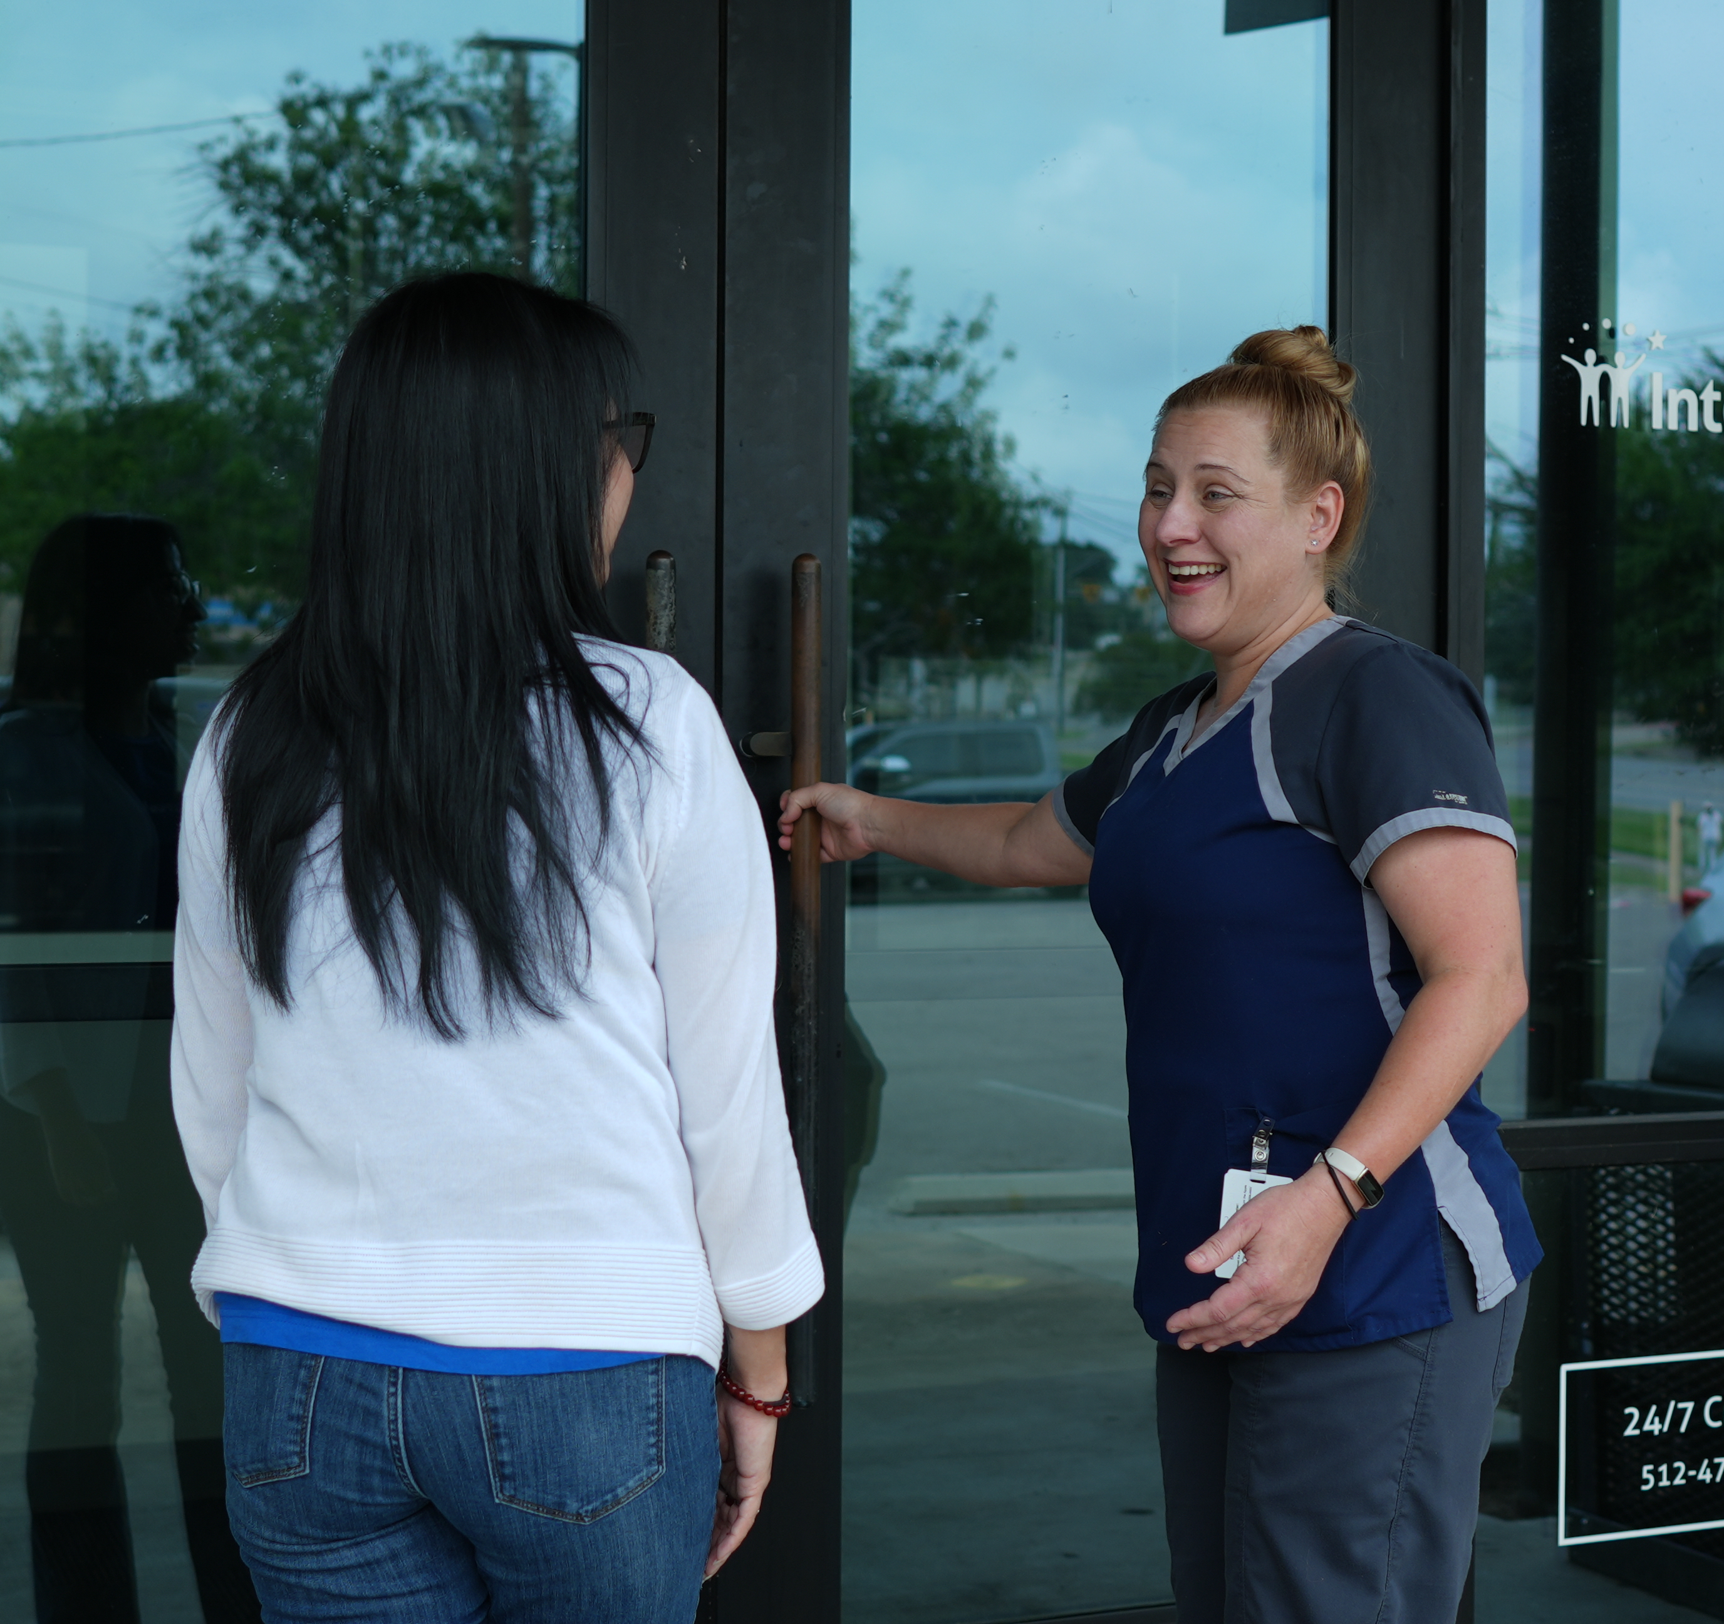
Our Care Approach
Person-Centered​
Trauma-Informed​
Culturally Competent​
Multiple Languages​
Integrated Care​
Community Partnerships

Slide 12
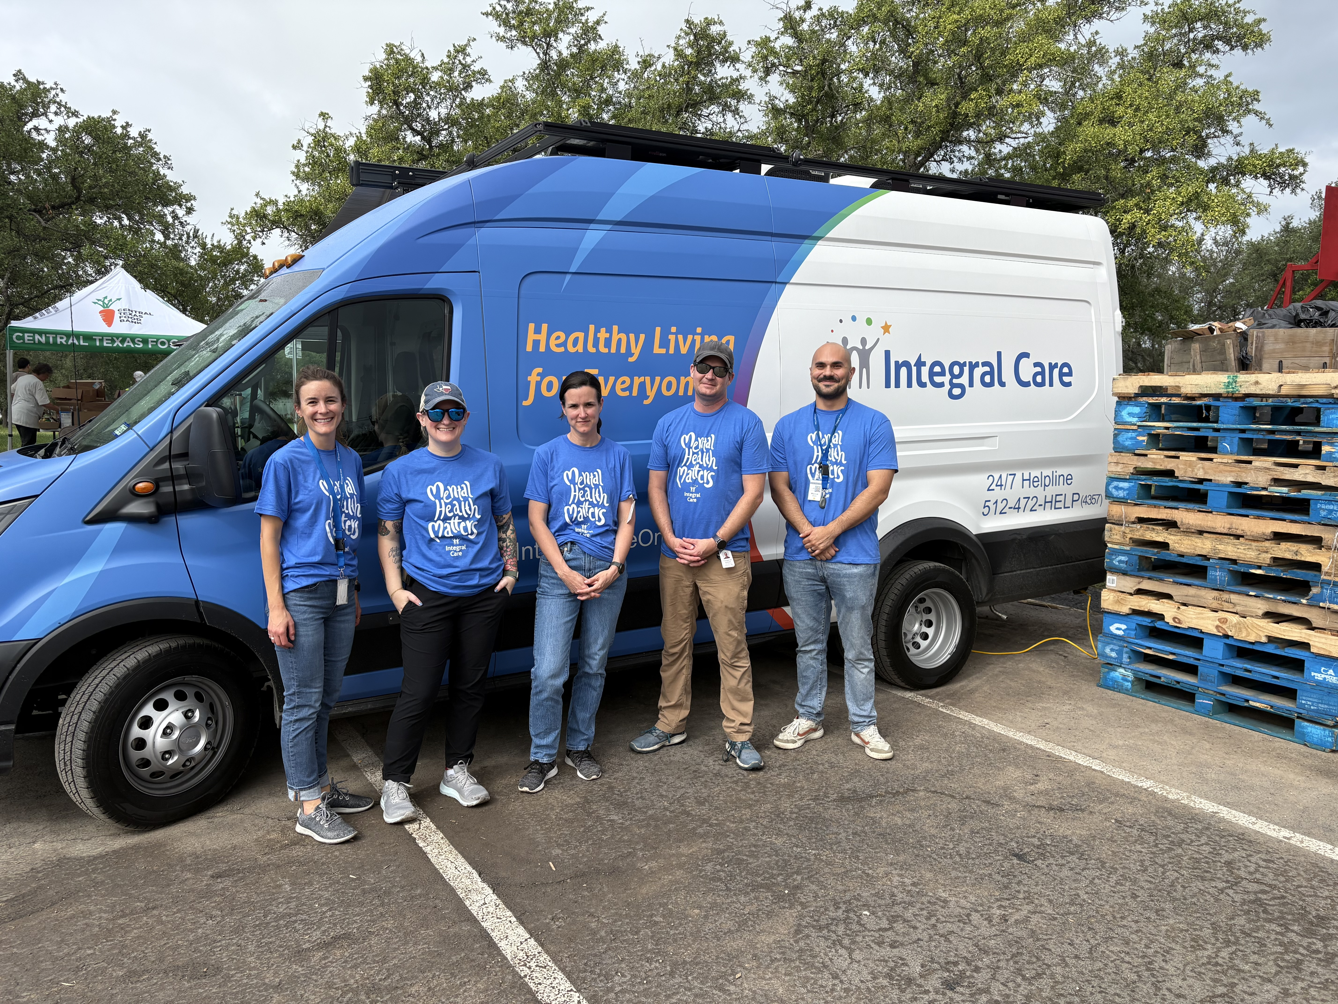
Where We Provide Services
Over the phone​
Via telehealth​
On a street corner ​
In homes​
In jails​
In clinics and residential facilities​
In emergency rooms​
In schools​
In mobile clinics

Slide 13
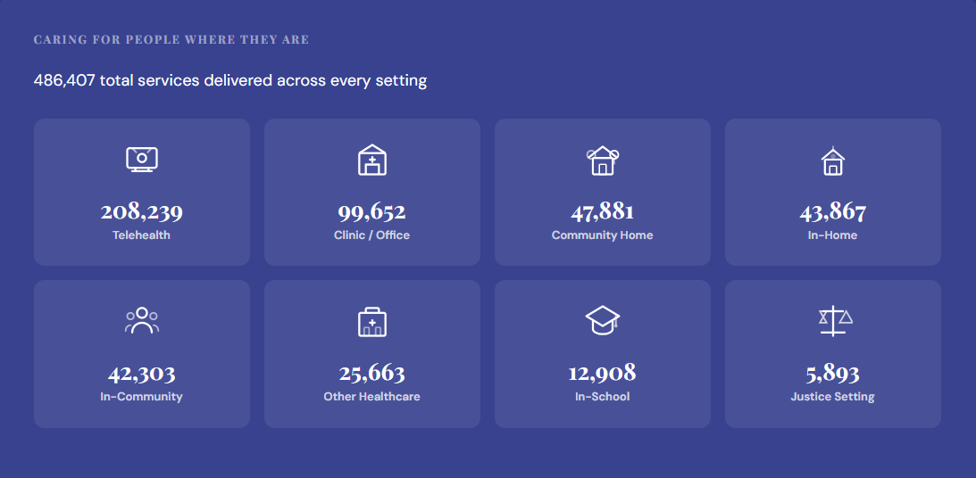
Where We Serve, By the Numbers

Slide 14
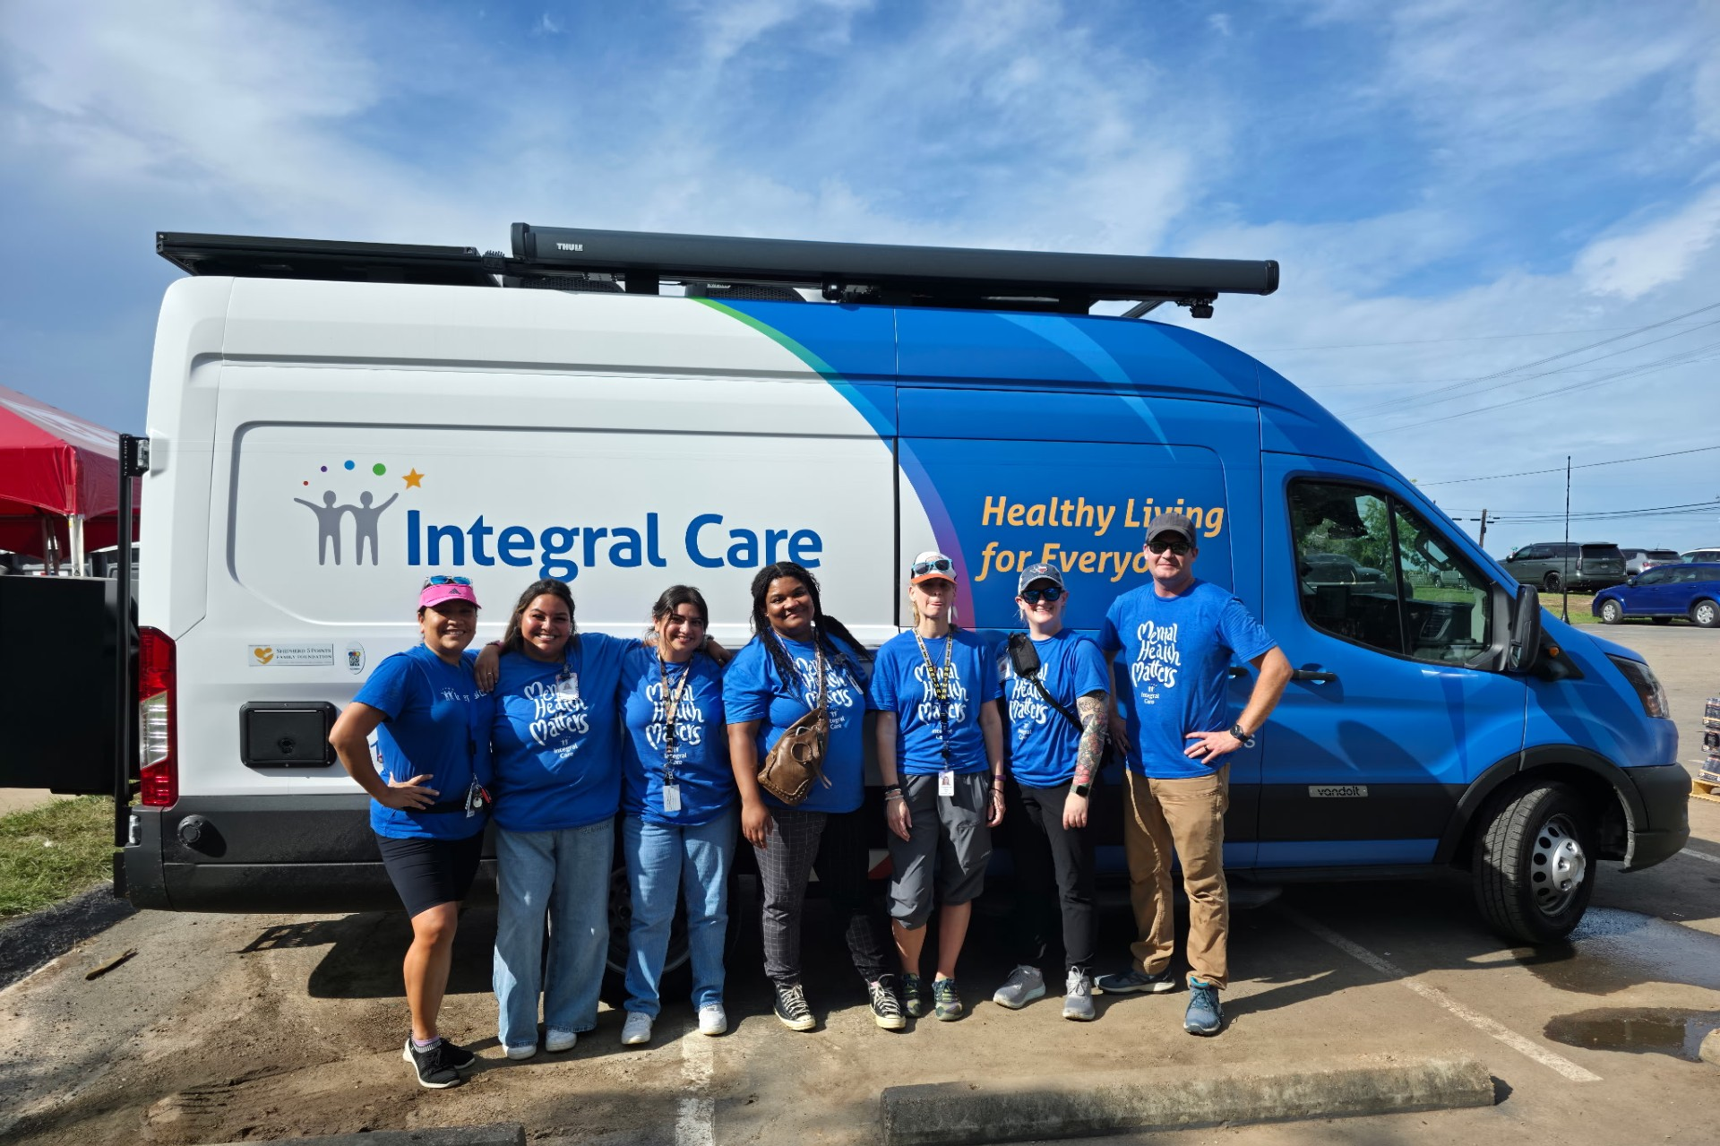
Mobile Clinics: Meeting Clients Where They Are
Launched in February 2025, the mobile mental health van dedicates 70% of its time to serving individuals experiencing homelessness.
The mobile unit travels to high-need locations including:
    Homeless shelters
    Encampments
    Downtown Austin Community Court
    Rural and underserved areas across Travis County
Fully equipped hub for integrated care, outfitted to deliver mental health, substance use, and general medical services in the field.
Notes:
Mobile Behavioral Health Clinics break through barriers by bringing care directly to the people who need it most.

Slide 15
Services: Adult Behavioral Health
We help people living with:
Depression, anxiety, and panic disorders
Suicidal thoughts or self-harming behavior
Paranoia, delusions, or schizophrenia
Substance use challenges involving alcohol, opioids, or other drugs
Trauma, grief, and the emotional impact of life changes
Intellectual and developmental disabilities (IDD)
Notes:
Individual and community well-being is built just like a house.
A strong foundation, the right tools and ongoing maintenance help us all weather life’s storms, like a mental health issue.
Integral Care provides the tools everyone needs to maintain well-being, reach their full potential, and contribute to our community.

Slide 16
Services: Child & Family Services
We offer personalized care that starts with a thorough, expert assessment.
Our team works closely with families to understand what’s really going on and create a care plan specific for the child and family.
Services may include individual therapy, family counseling, in-home visits, in-school visits, prescribing and managing medication, treatment for substance use, and suicide prevention.
Notes:
Child and Family services may include individual therapy, family counseling, in-home visits, in-school visits in Pflugerville, Del Valle and Manor, prescribing and managing medication, treatment for substance use, and suicide prevention.
We’re here for parents, too. We offer tools and guidance on topics like communication strategies, setting routines, managing screen time, and handling social media bullying.

Slide 17
Services: Crisis
Integral Care offers mental health crisis support 24 hours a day, 7 days a week – on the phone and in the community. Our crisis services help people recover from a mental health crisis and rebuild their well-being.
  A 24-hour helpline at 512-472-HELP (4357).
  A 24/7 walk-in Psychiatric Emergency Services (PES) location at 1165 Airport Blvd.
  Mental health related 911 calls are routed directly to Integral Care’s Expanded Mobile Crisis Outreach Team (EMCOT) for immediate de-escalation support from the moment an individual contacts emergency services.
Notes:
Urgent challenges like suicidal thoughts, overwhelming stress, or substance use concerns won’t necessarily occur on a 9-5 schedule. That’s why Integral Care offers:
A 24-hour helpline at 512-472-HELP (4357).
A 24/7 walk-in Psychiatric Emergency Services (PES) location at 1165 Airport Blvd.

Slide 18




Services: Intellectual & Developmental Disabilities
A diagnosis opens the door to vital services. We provide assessments to determine if someone qualifies for an IDD diagnosis. An official diagnosis is the key to accessing education support, SSI benefits, Medicaid waivers, and other critical services. We help families and caregivers navigate a complicated system.
We help people gain health and independence in their lives.
Access stable jobs
Form healthy relationships
Live independently
Crisis support
Notes:
A healthy community creates opportunities for everyone to share their gifts and talents and make meaningful contributions.
Integral Care’s programs and services create opportunities for people to form healthy relationships, access stable jobs and live independently.

Slide 19
Helpline Calls
Rapid, community-based crisis response services 24 hours a day, seven days a week.
24/7 Helpline
One of four designated National Suicide and Crisis Prevention Lifeline centers in Texas
Accessibility via phone, text, and chat
Direct connection to all Integral Care programs and services
988 Suicide and Crisis Lifeline
When an individual calls 988 from an area code covered by Integral Care, the call is routed directly to the Helpline team
Taking calls for more than 70 Central Texas counties
All calls are answered by trained mental health professionals
198,964
calls handled last year

Slide 20

Housing Services
We believe access to housing is key to a person’s ability to regain health and maintain independence in their lives.
Our team members are out in the community every day, at food panties, soup kitchens, public libraries, overnight shelters, and more.
We help unhoused adults start accessing no-cost mental healthcare, get drug and alcohol treatment, access local resources, and complete their Coordinated Entry paperwork. We help people navigate a complicated system.
Notes:
Achieving good health and wellness is difficult when someone doesn’t have stable housing. Think about it: how can someone store food and medication, get proper rest, or practice good hygiene if they don’t have a home? As part of our mental health recovery programs, Integral Care has multiple ways to help people access stable, affordable housing.

Slide 21
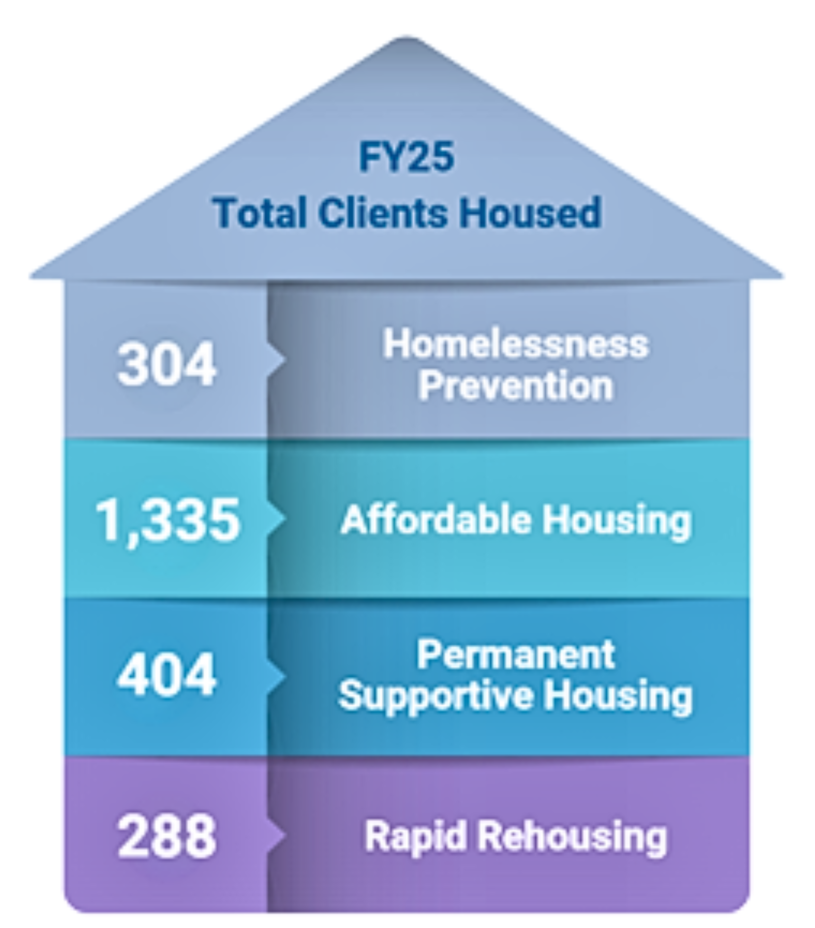
Housing Services Impact
Stable housing is foundational to recovery, health, and overall well-being.
In FY25, 1 in 5 Integral Care clients experienced homelessness.
A full continuum of housing and homeless services to move individuals from crisis and street homelessness to long-term housing stability.
Homelessness prevention, rapid rehousing, affordable housing development, and permanent supportive housing.
In FY25, 3,932 clients were served through Homeless Outreach & Housing Services.
Notes:
Currently, Integral Care operates two Permanent Supportive Housing complexes:
The Terrace at Oak Springs (50 units)
The Bungalows at Century Park (60 units)
Seabrook Square (opening March/April 2026) (60 units)
Together these apartment complexes provide 110 apartment units for our residents, plus on-site services like healthcare, counseling, job assistance, and more, all in one place. This helps people get their lives back on track and stay there- for good.

Slide 22
Who We Serve

Slide 23
FY25 Overview
29,327
486,407
1,172
30+
Total Clients Served
Services provided
Integral Care Staff
Programs and services offered

Slide 24
Number of Services Provided FY25
486,407
Total services provided

Slide 25
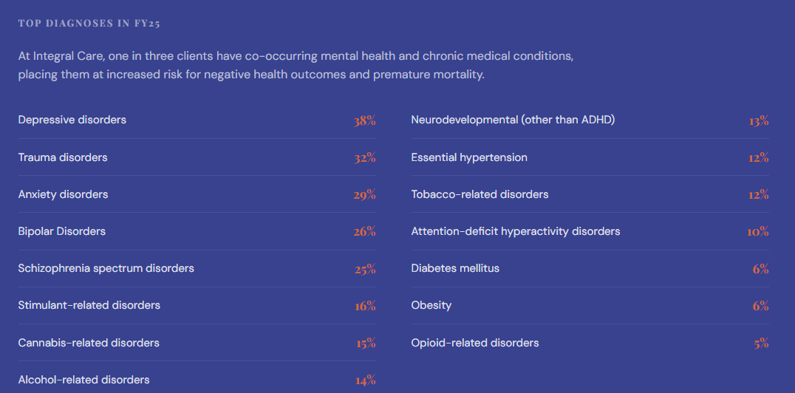
Who We Serve: FY25 Top Client Diagnoses
Notes:
See note about co-occurring, example of substance use disorder.
Other mental and cognitive disorders includes conditions like anxiety, personality disorders and dementia.
Developmental and behavioral conditions include intellectual and developmental disabilities, autism and other developmental disorders.

Slide 26
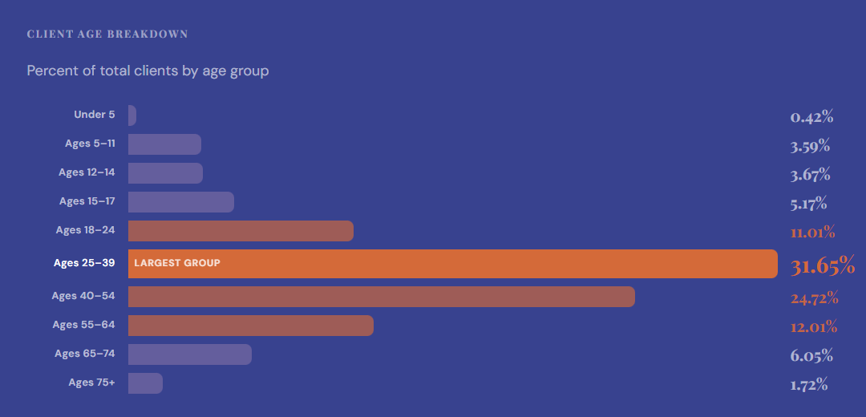
Client Demographics FY25 | Age

Slide 27
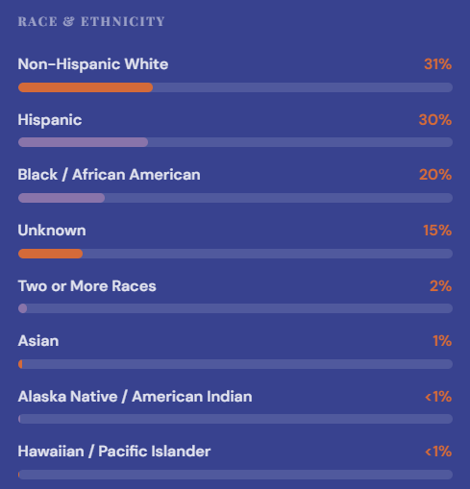
Client Demographics FY25 | Race & Ethnicity
Top Languages Spoken by Clients
English
Spanish
American Sign Language
97%
Clients Living in Poverty
19%
Clients Experiencing Homelessness

Slide 28
Q&A

Slide 29
Thank you.
integralcare.org
512-472-4357
24/7 HELPLINE

